Slide 1
INTRODUCTION TO GITHUB
Programming for Bioinformatics
SECB3203
Semester 1, Session 2021/2022

Slide 2
GitHub
online hosting service for Git repositories.
used for version control.
store your repo on their platform.
ability to collaborate with other developers from any location, especially when more than just one person is working on a project. For example, a software development team wants to build a website, and everyone must update their codes simultaneously while working on the project. In this case, GitHub helps them to build a centralized repository where everyone can upload, edit, and manage the code files.
Reference:
https://www.edureka.co/blog/how-to-use-github/
https://www.freecodecamp.org/news/git-and-github-for-beginners/

Slide 3
Git
version control system that lets you track changes you make to your files over time.
you can revert to various states of your files (like a time-travelling machine).
you can also make a copy of your file, make changes to that copy, and then merge these changes to the original copy.
Note: version control system refers to the method used to save a file's versions for future reference.
Reference:
https://www.freecodecamp.org/news/git-and-github-for-beginners/
https://www.freecodecamp.org/news/git-and-github-overview/

Slide 4
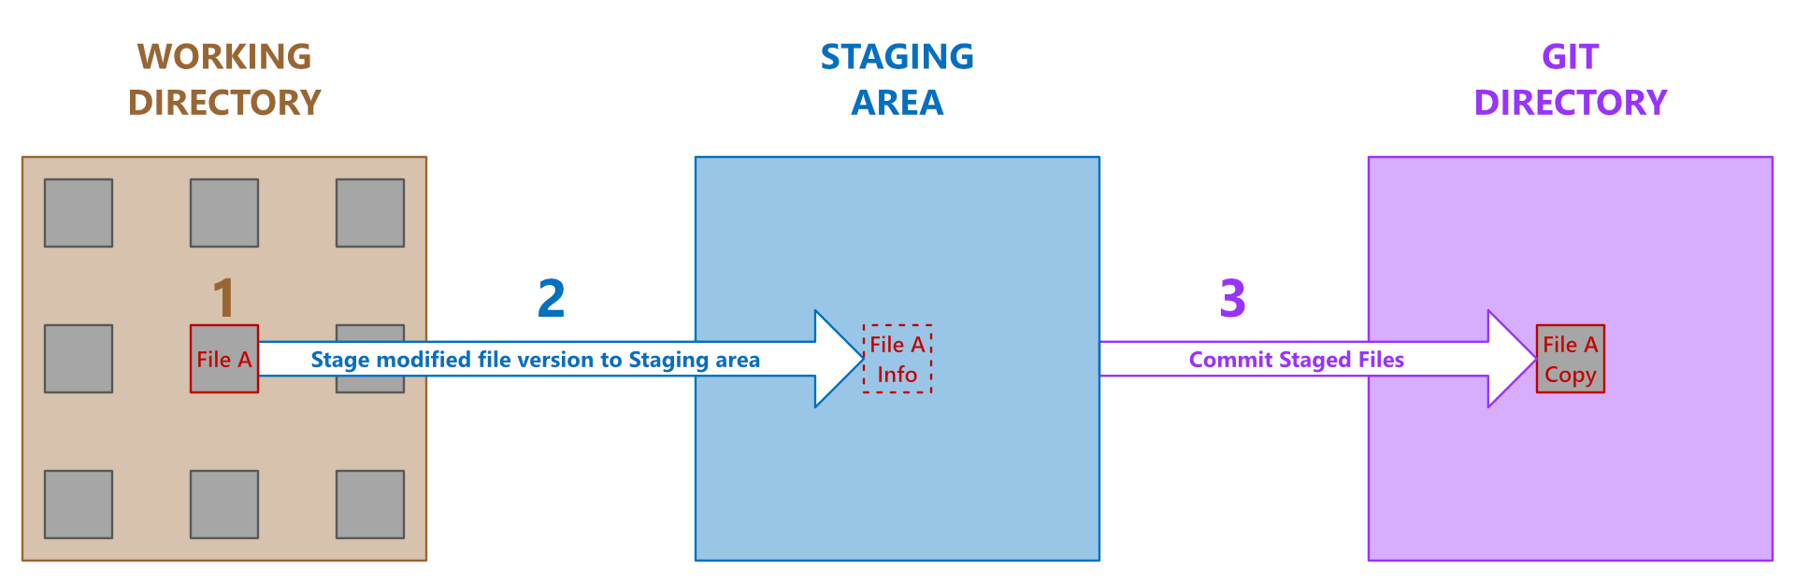
Git - Workflow
There are three key places versions of a file may reside while version controlling with Git:
the working directory (local folder for a project's files), the staging area (technically called “index” in Git parlance), or the Git directory (Git creates inside the working directory you have instructed it to track).
Reference:
https://www.freecodecamp.org/news/git-and-github-overview/

Slide 5
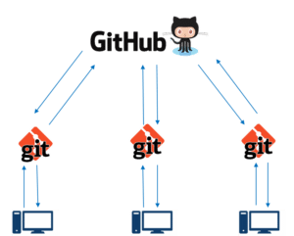
GitHub: a central repository Git: a version control tool
Git is a version control tool that will allow you to perform all kinds of operations to fetch data from the central server or push data to it.
GitHub is a core hosting platform for version control collaboration.
GitHub is a company that allows you to host a central repository in a remote server.
Reference: https://www.edureka.co/blog/how-to-use-github/

Slide 6
Git vs. GitHub
Difference 1: Primary function
Git is a distributed version control system that records different versions of a file (or set of files). It lets users access, compares, updates, and distribute any of the recorded version(s) at any time.
GitHub is mainly a hosting platform for hosting Git repositories online. It lets users keep their remote repository private or open for collaborative endeavors.
Reference:
https://www.freecodecamp.org/news/git-and-github-overview/

Slide 7
Git vs. GitHub
Difference 2: Operation platform
Users install and operate Git on their local machines. This means that most of Git's operations are achievable without the internet.
GitHub is a web-based service that operates solely online. This means that you need the internet to do anything on GitHub.
Reference:
https://www.freecodecamp.org/news/git-and-github-overview/

Slide 8
Working with Git
Initialize Git on a folder, making it a Repository Note: A repository is a storage space of your project
Clone a project to work on a local copy / Git now creates a hidden folder to keep track of changes in that folder
When a file is changed, added or deleted, it is considered modified
Reference:
https://www.w3schools.com/git/git_intro.asp
https://www.youtube.com/watch?v=PQsJR8ci3J0

Slide 9
Git: Tutorial
Install
download: https://www.git-scm.com/
Using Command Line
git --version
Configure Git
(Note: Change the username and e-mail address to yours. You will probably use this when registering to GitHub later. Use global for every repository on your computer.)
git config --global user.name “secb3203"
git config --global user.email “secb3203@utm.my"
Reference:
https://www.w3schools.com/git/git_getstarted.asp?remote=github

Slide 10
Git: Tutorial (continued…)
Creating Git Folder
makes a new directory
mkdir myproject
changes the current working directory
cd myproject
Initialize Git
git init
Check the Git status
git status
Reference:
https://www.w3schools.com/git/git_getstarted.asp?remote=github

Slide 11
Working with Git (continued…)
You select the modified files you want to Stage (Staging)
The Staged files are Committed (Committing), which prompts Git to store a permanent snapshot of the files
Branch and Merge to allow for work on different parts and versions of a project
Pull the latest version of the project to a local copy
Push local updates to the main project
Reference:
https://www.w3schools.com/git/git_intro.asp

Slide 12
Git: Tutorial (continued…)
Git Staging Environment
add the file to the Staging Environment
git add index.html
add all files in the current directory to the Staging Environment
git add --all
Git Commit
(Note: The commit command performs a commit, and the -m "message" adds a message.)
git commit -m "First release of Hello World!"
Reference:
https://www.w3schools.com/git/git_getstarted.asp?remote=github

Slide 13
Git: Tutorial (continued…)
Working with Git Branches
New Git Branch: create a new branch
git branch hello-world-images
Checkout: check out a branch
git checkout hello-world-images
Delete the hello-world-images branch
git branch -d hello-world-images
Merge Branches (Note: merge the current branch (master) with emergency-fix)
git merge emergency-fix
Reference:
https://www.w3schools.com/git/git_getstarted.asp?remote=github

Slide 14
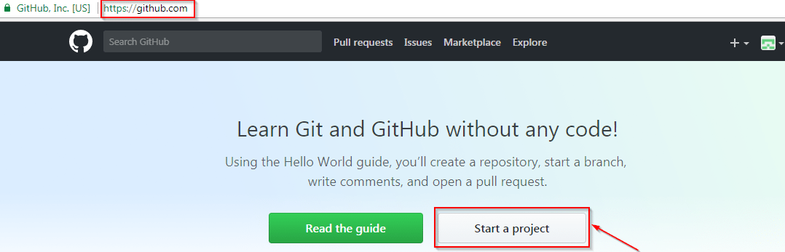
GitHub: Tutorial
Go to https://github.com/
Fill the sign-up form and click on “Sign up for Github”.
Click on “Start a new project”.
Reference:
https://www.edureka.co/blog/how-to-use-github/
https://youtu.be/PQsJR8ci3J0

Slide 15
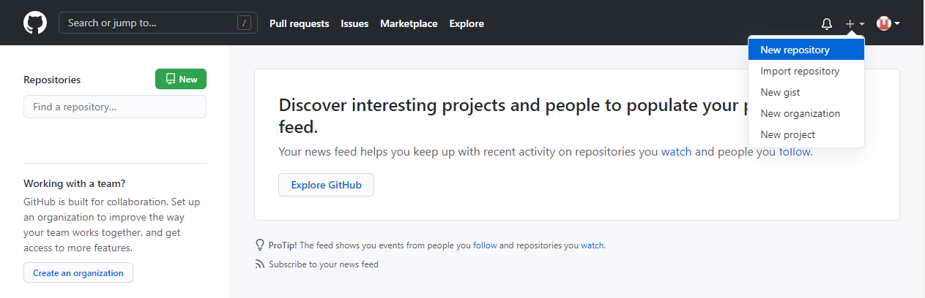
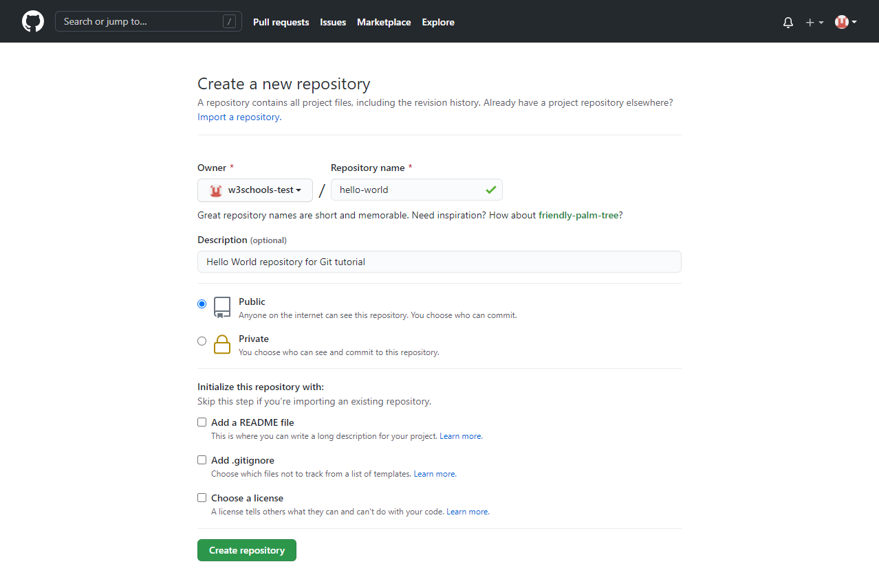
GitHub: Tutorial (continued…)
Create a Repository on GitHub
Reference:
https://www.w3schools.com/git/git_remote_getstarted.asp?remote=github

Slide 16
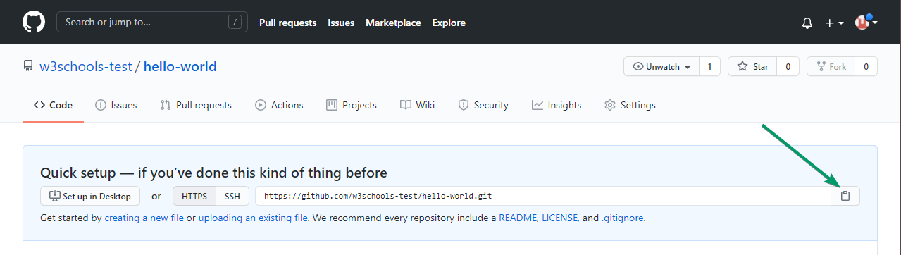
GitHub: Tutorial (continued…)
Push Local Repository to GitHub
Copy the URL, or click the clipboard marked in the image above, then paste it (Note: git remote add origin URL specifies adding a remote repository, with the specified URL, as an origin)
git remote add origin https://github.com/w3schools-test/hello-world.git
Reference:
https://www.w3schools.com/git/git_remote_getstarted.asp?remote=github

Slide 17
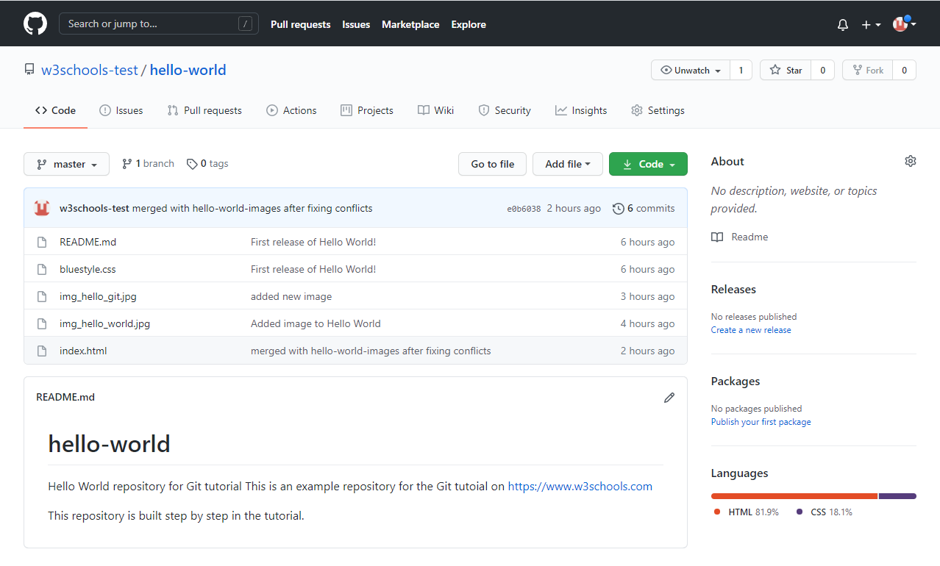
GitHub: Tutorial (continued…)
push our master branch to the origin URL
git push --set-upstream origin master
go back into GitHub and see that the repository has been updated
Reference:
https://www.w3schools.com/git/git_remote_getstarted.asp?remote=github

Slide 18
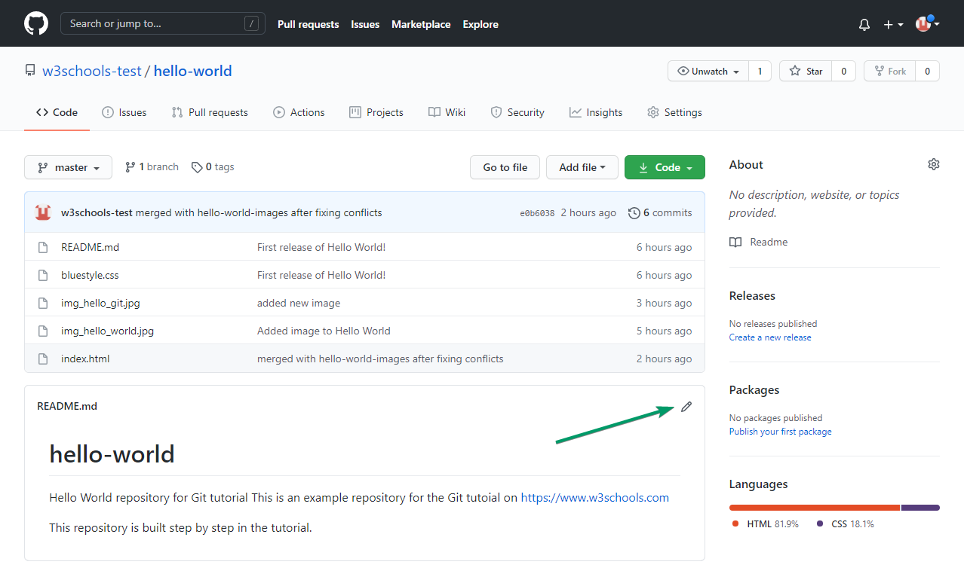
GitHub: Tutorial (continued…)
Edit Code in GitHub
Reference:
https://www.w3schools.com/git/git_remote_getstarted.asp?remote=github

Slide 19
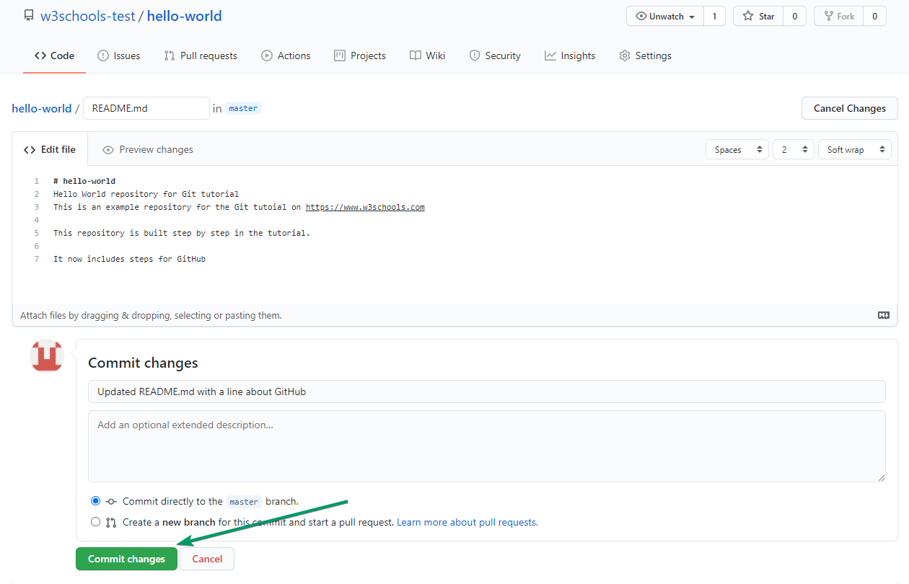
GitHub: Tutorial (continued…)
Add some changes to the code, and then commit the changes. For now, we will "Commit directly to the master branch".
Reference:
https://www.w3schools.com/git/git_remote_getstarted.asp?remote=github

Slide 20
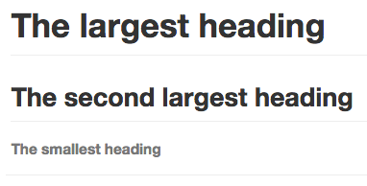

Basic writing and formatting syntax
Filename: README.md
# The largest heading
## The second largest heading
###### The smallest heading
Text that is not a quote
> Text that is a quote
Reference: https://docs.github.com/en/github/writing-on-github/getting-started-with-writing-and-formatting-on-github/basic-writing-and-formatting-syntax

Slide 21
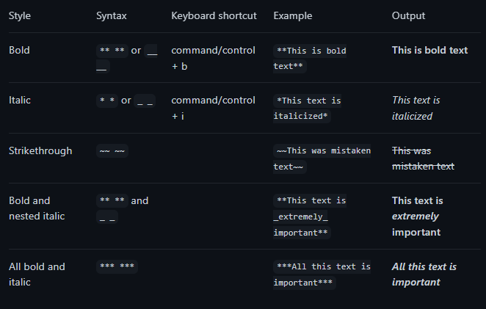
Basic writing and formatting syntax (continued…)
Filename: README.md
Reference: https://docs.github.com/en/github/writing-on-github/getting-started-with-writing-and-formatting-on-github/basic-writing-and-formatting-syntax

